Slide 1
3
2
1
h=2
h=1
beam
Figure 1

Slide 2
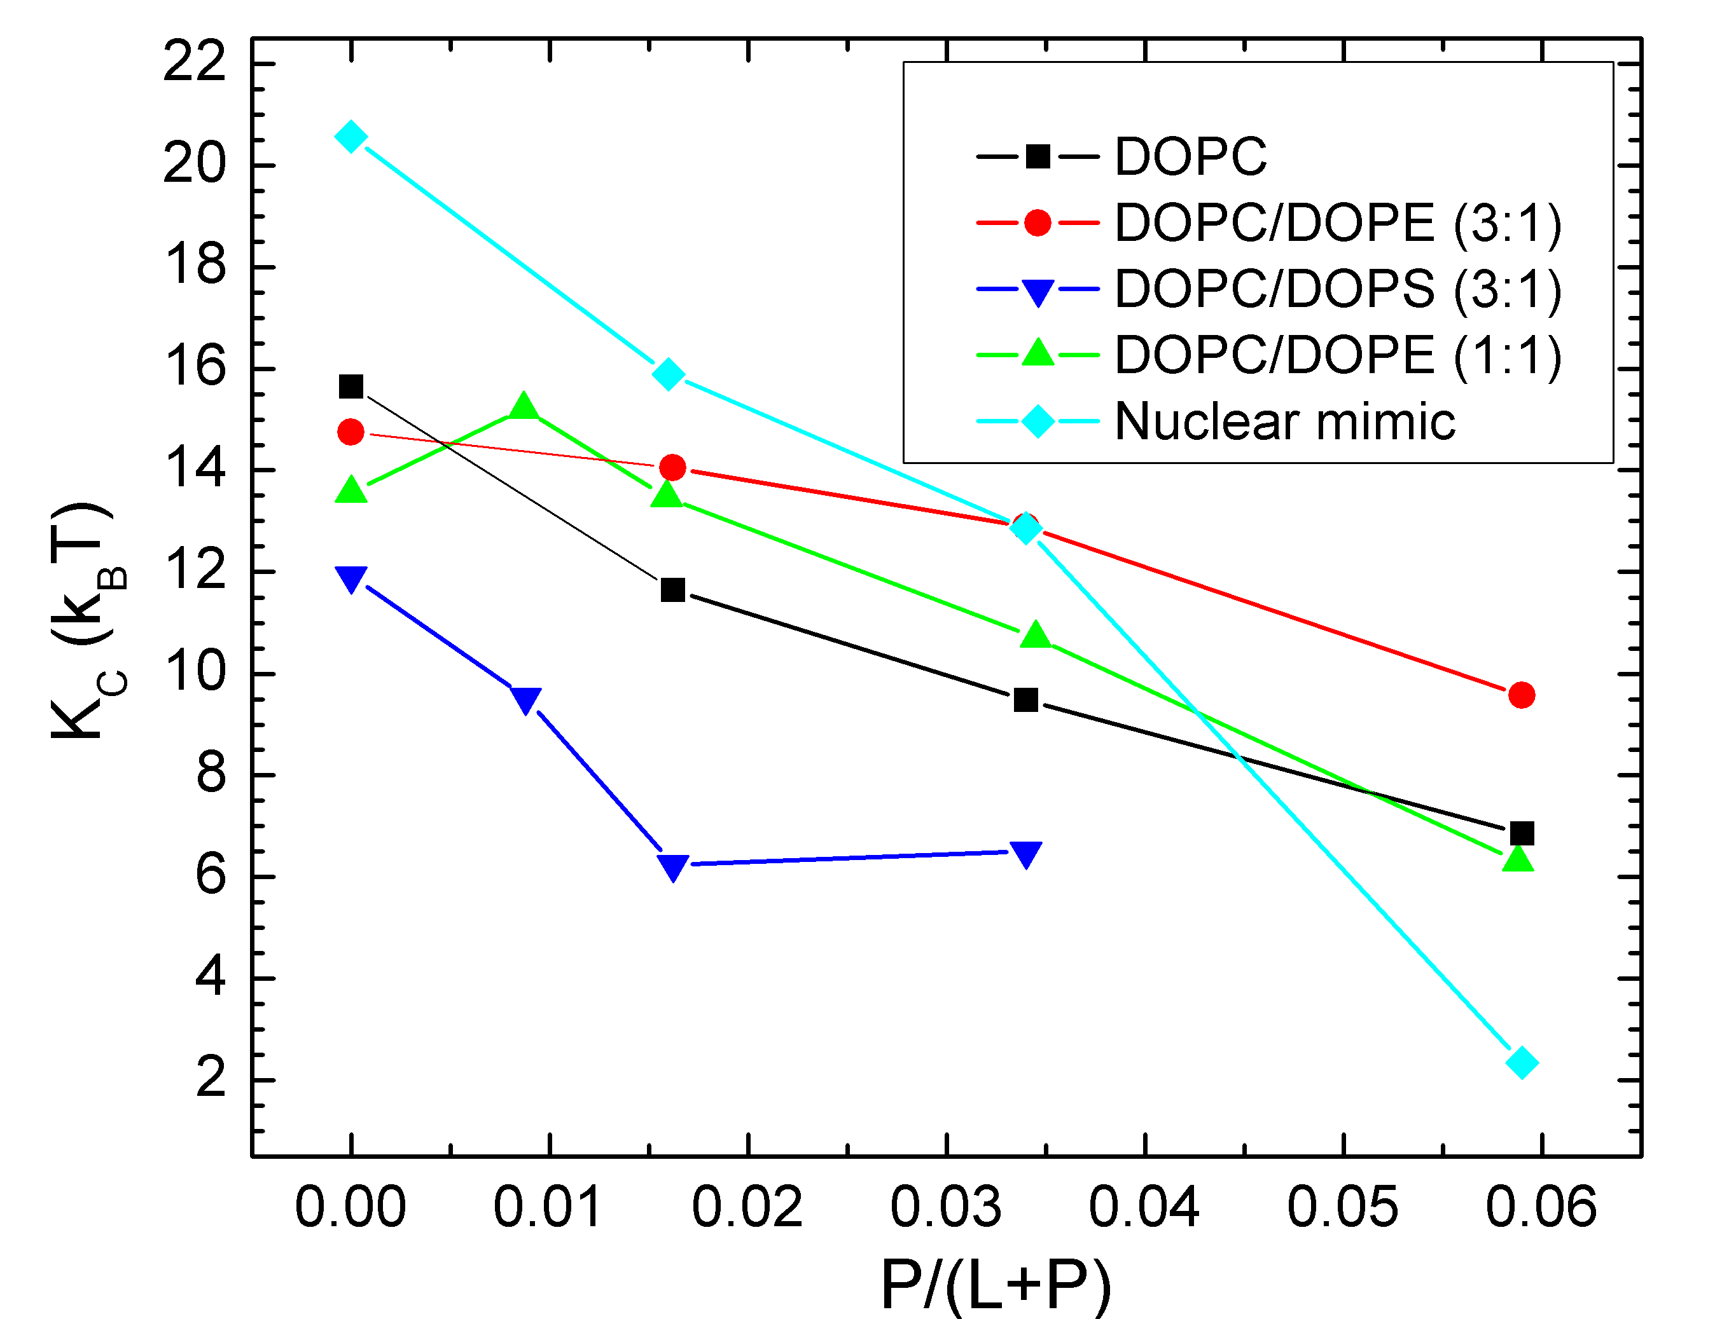
Figure 2

Slide 3
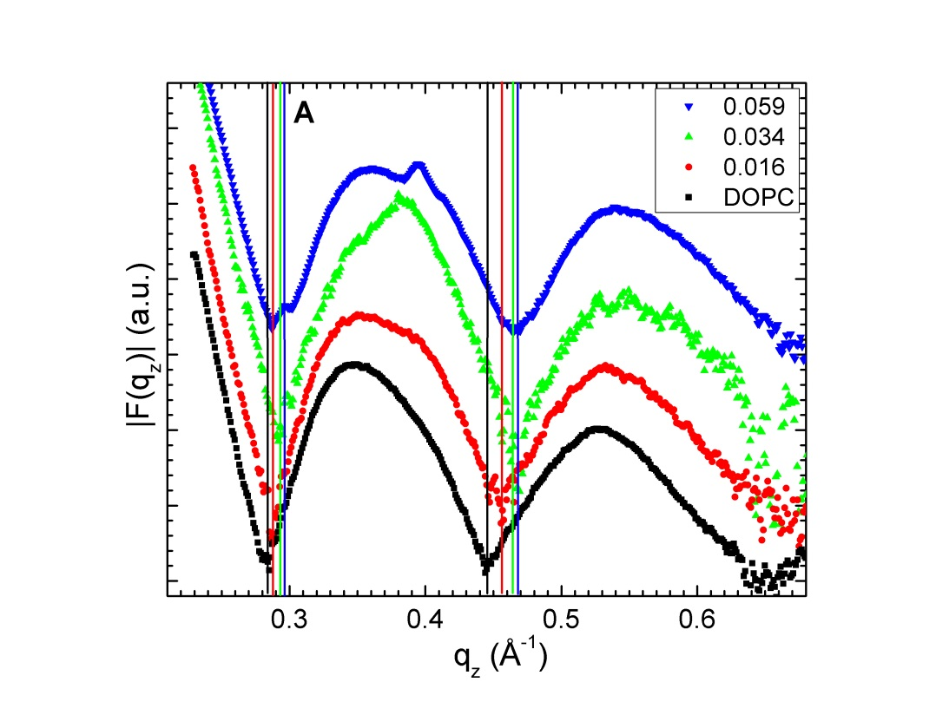
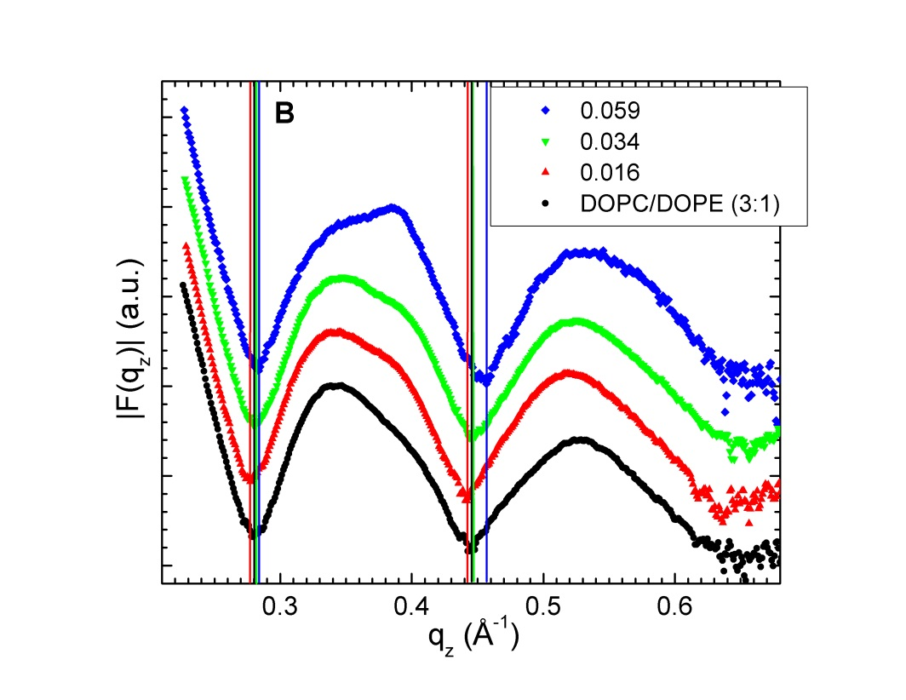
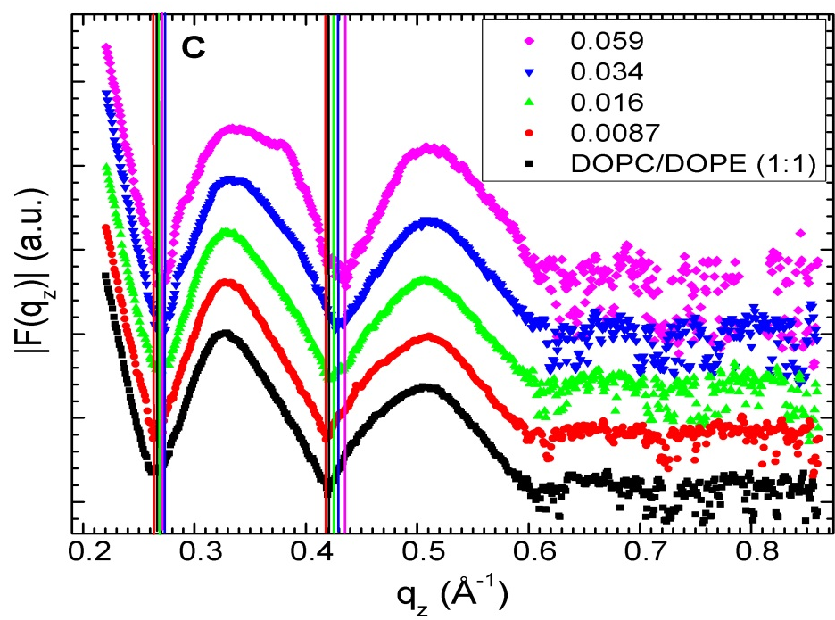
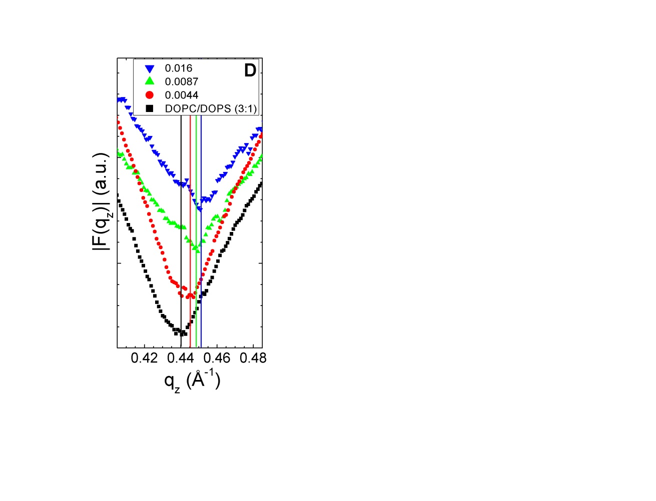
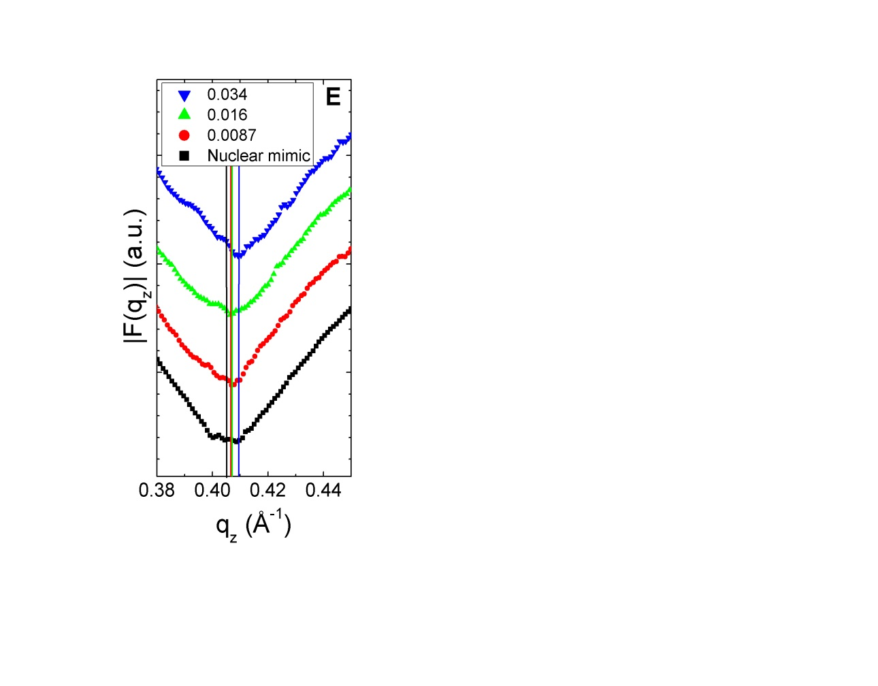
Figure 3

Slide 4
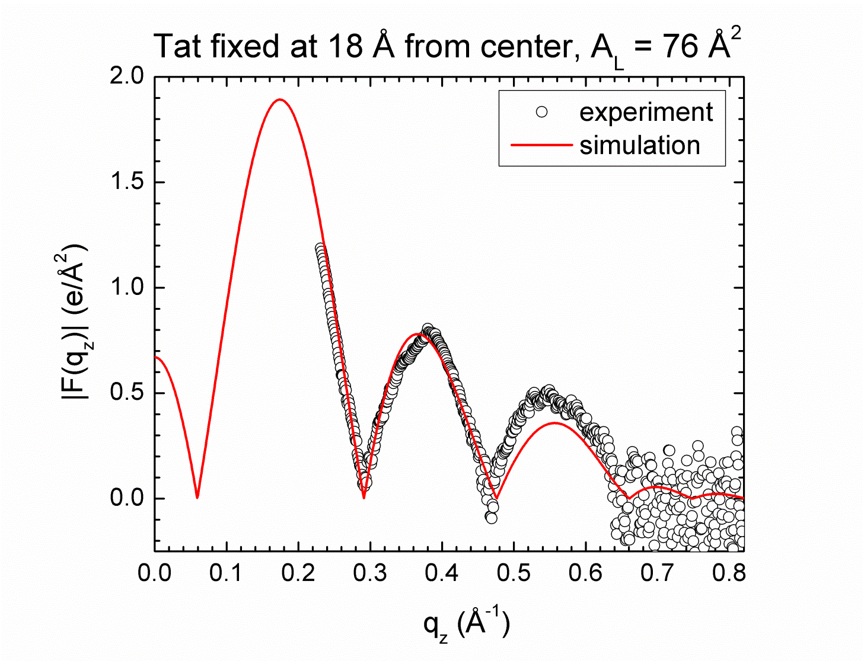
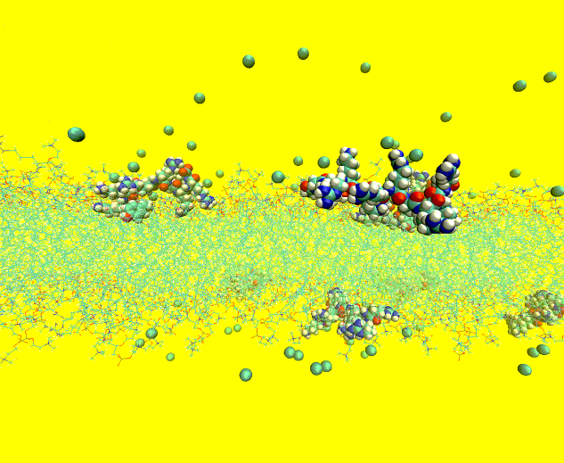
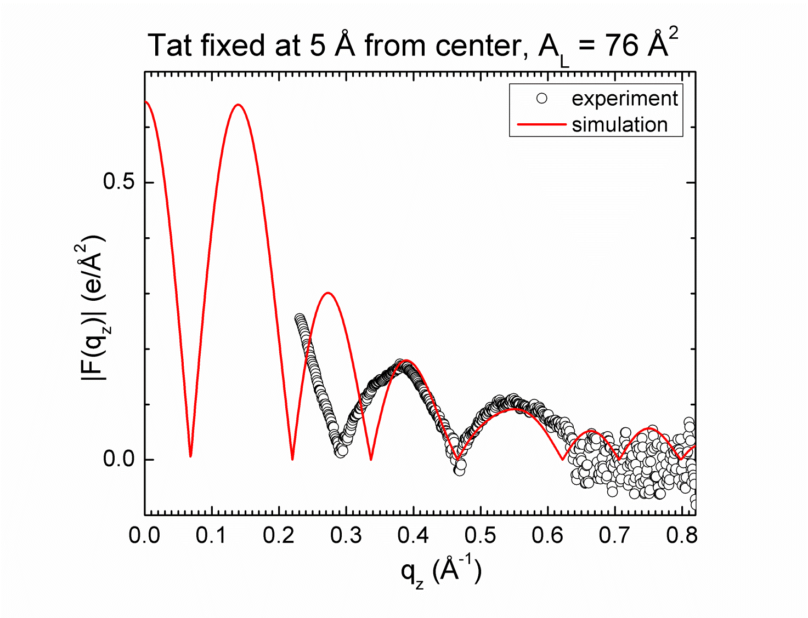
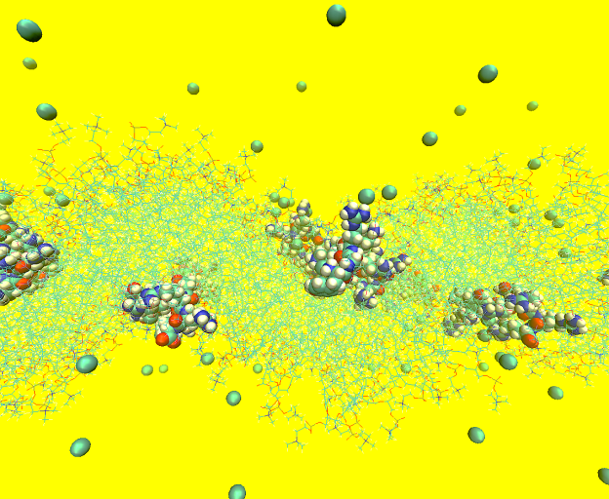
A B
C D
Figure 4

Slide 5
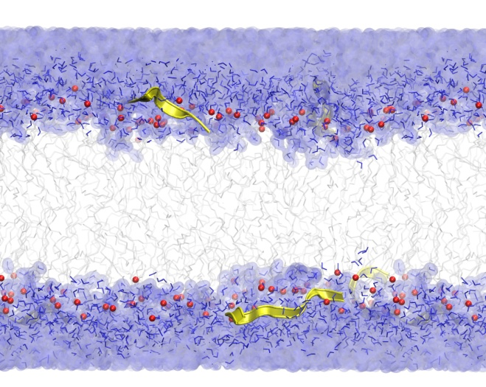
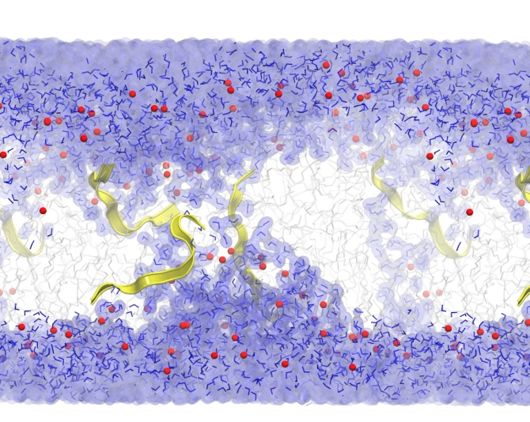
X-ray form factors MD simulations
A B
C D
Lipid bilayer
Tat

Slide 6
A B
C D

Slide 7
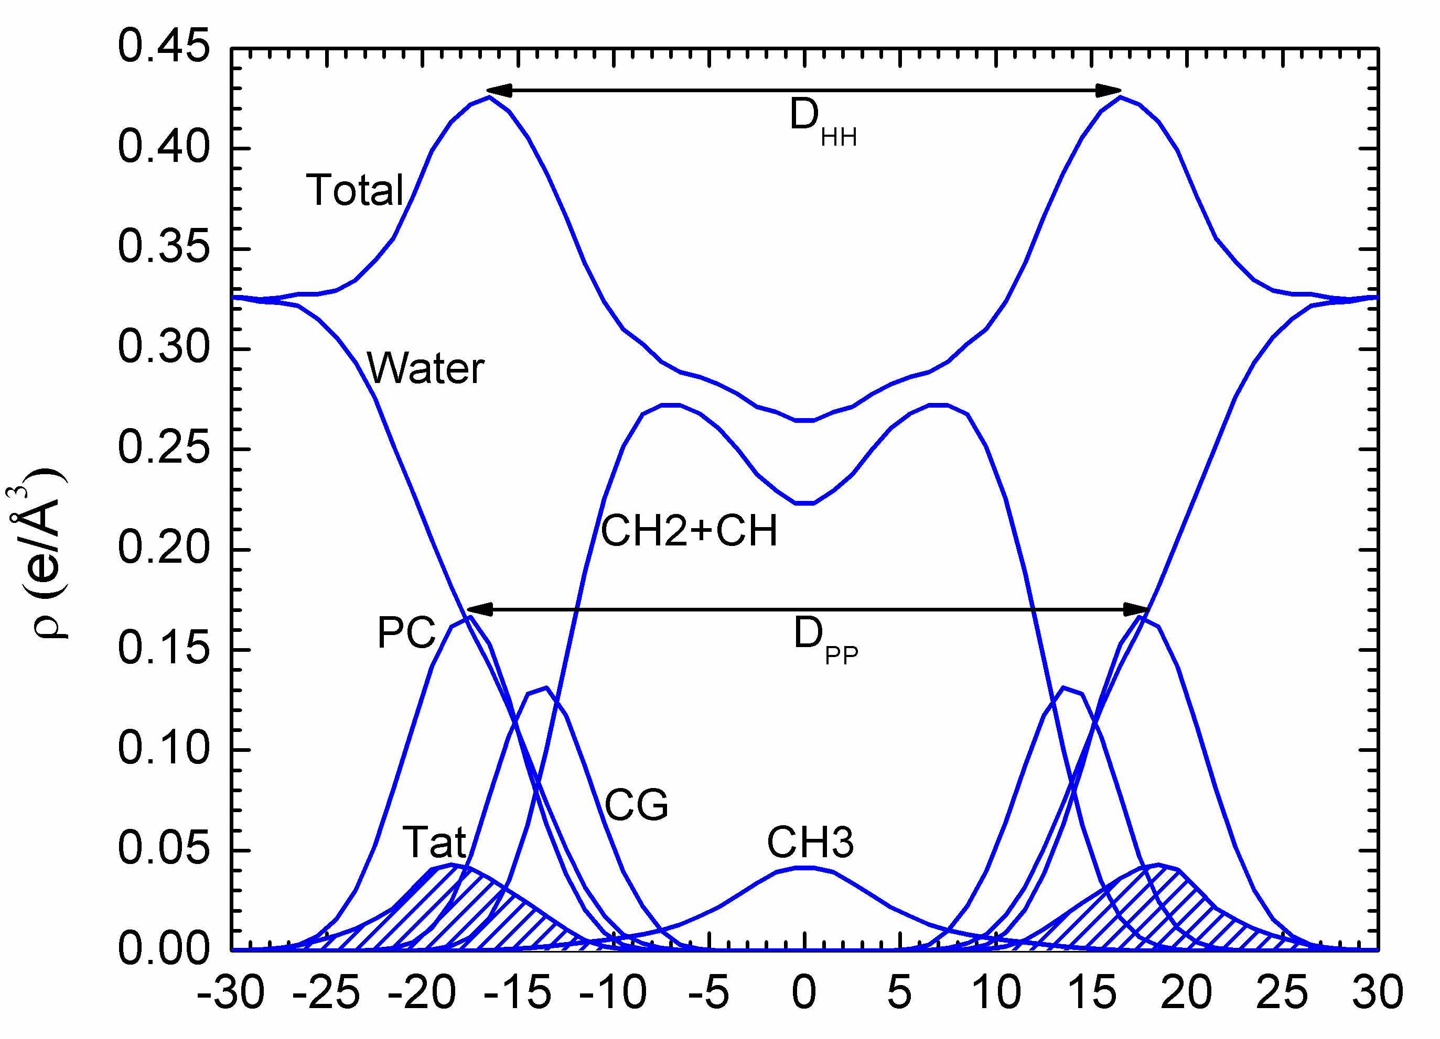
Z (Å)
Figure 5

Slide 8
A
B
C
Z (Å)
Figure 6

Slide 9
A B
C D
2 z_{Tat} (Å)
Figure 7

Slide 10
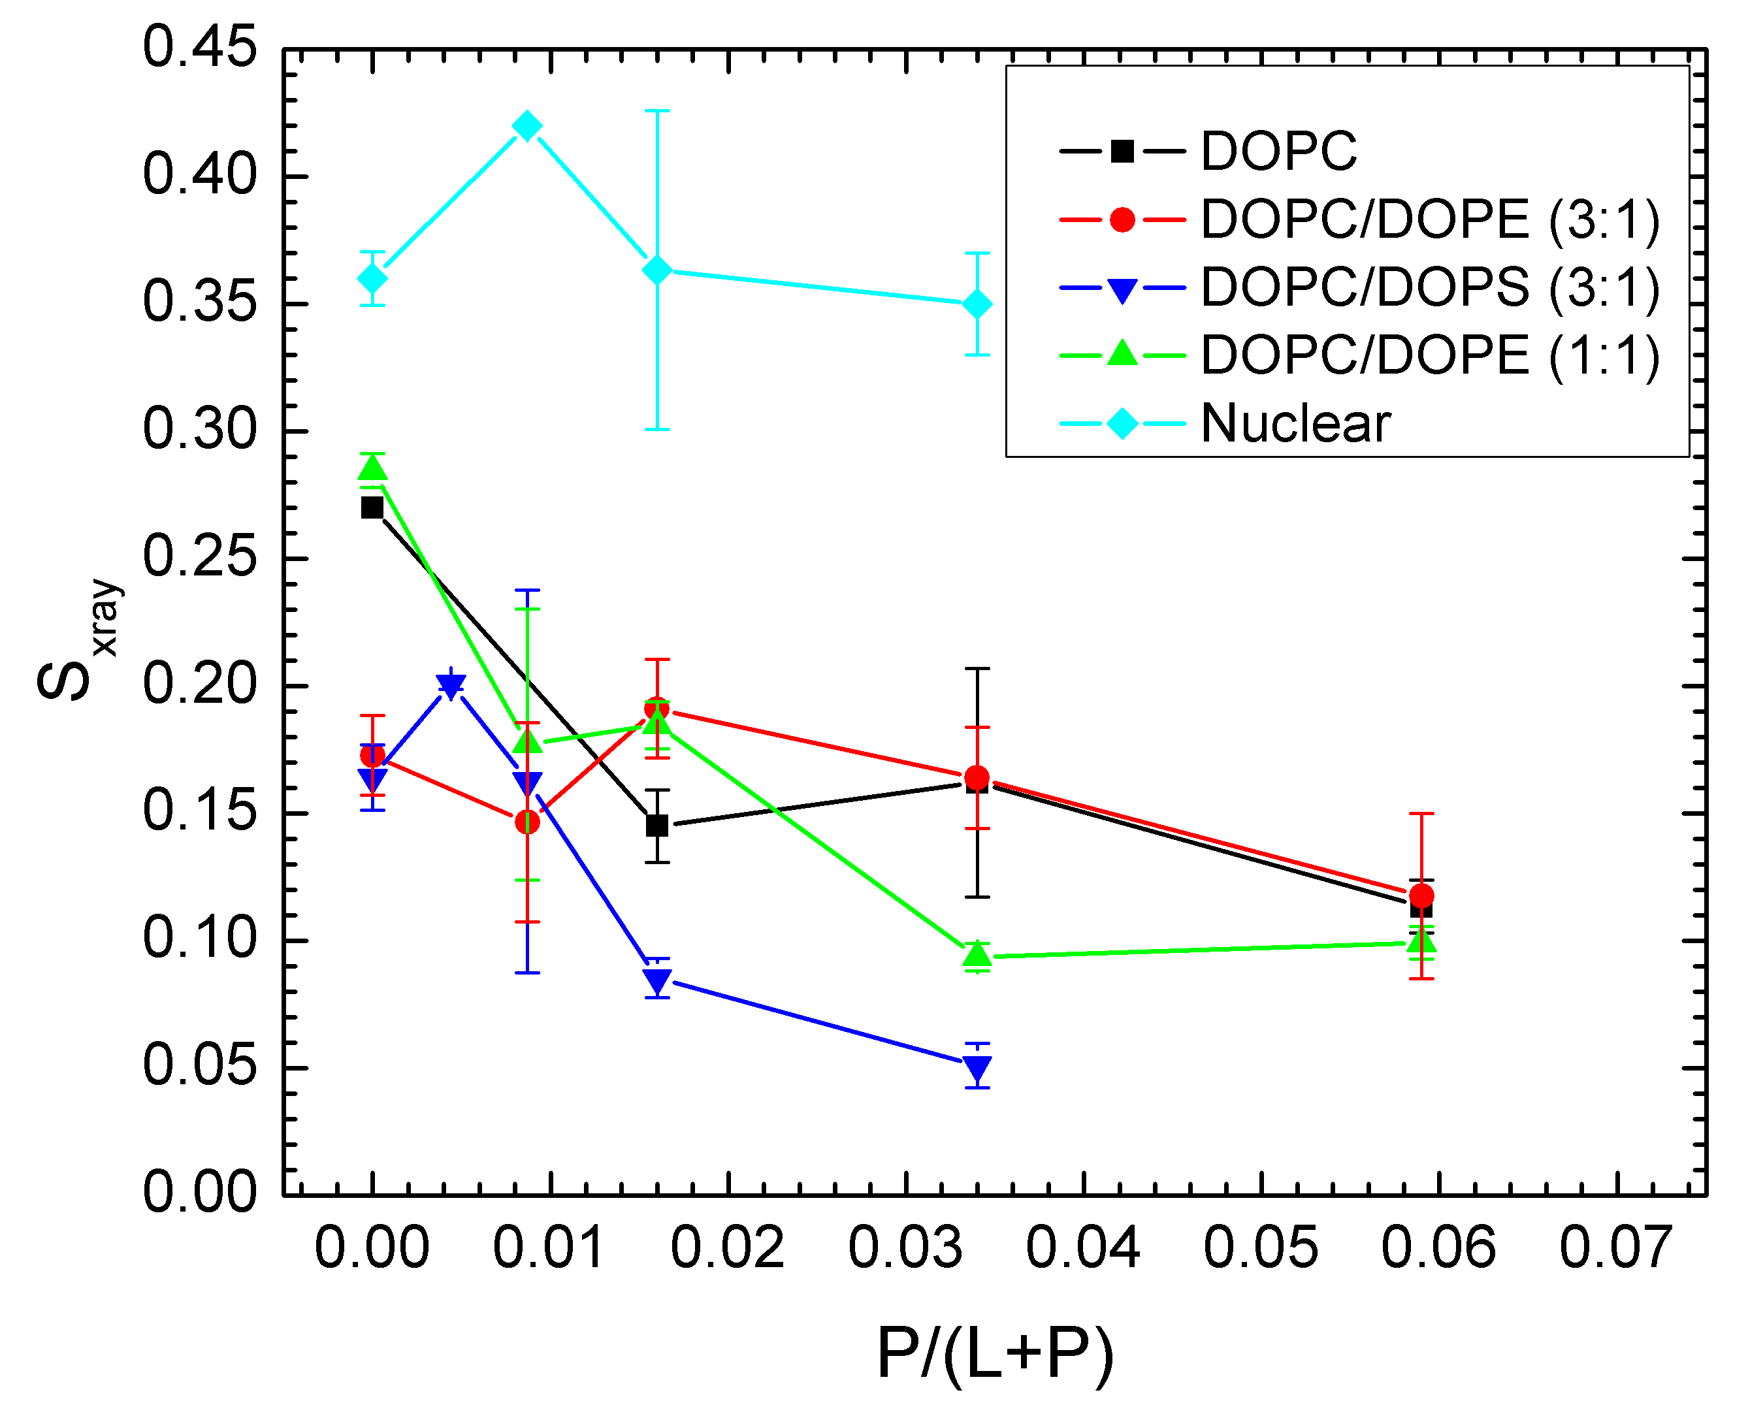
Figure 8

Slide 11
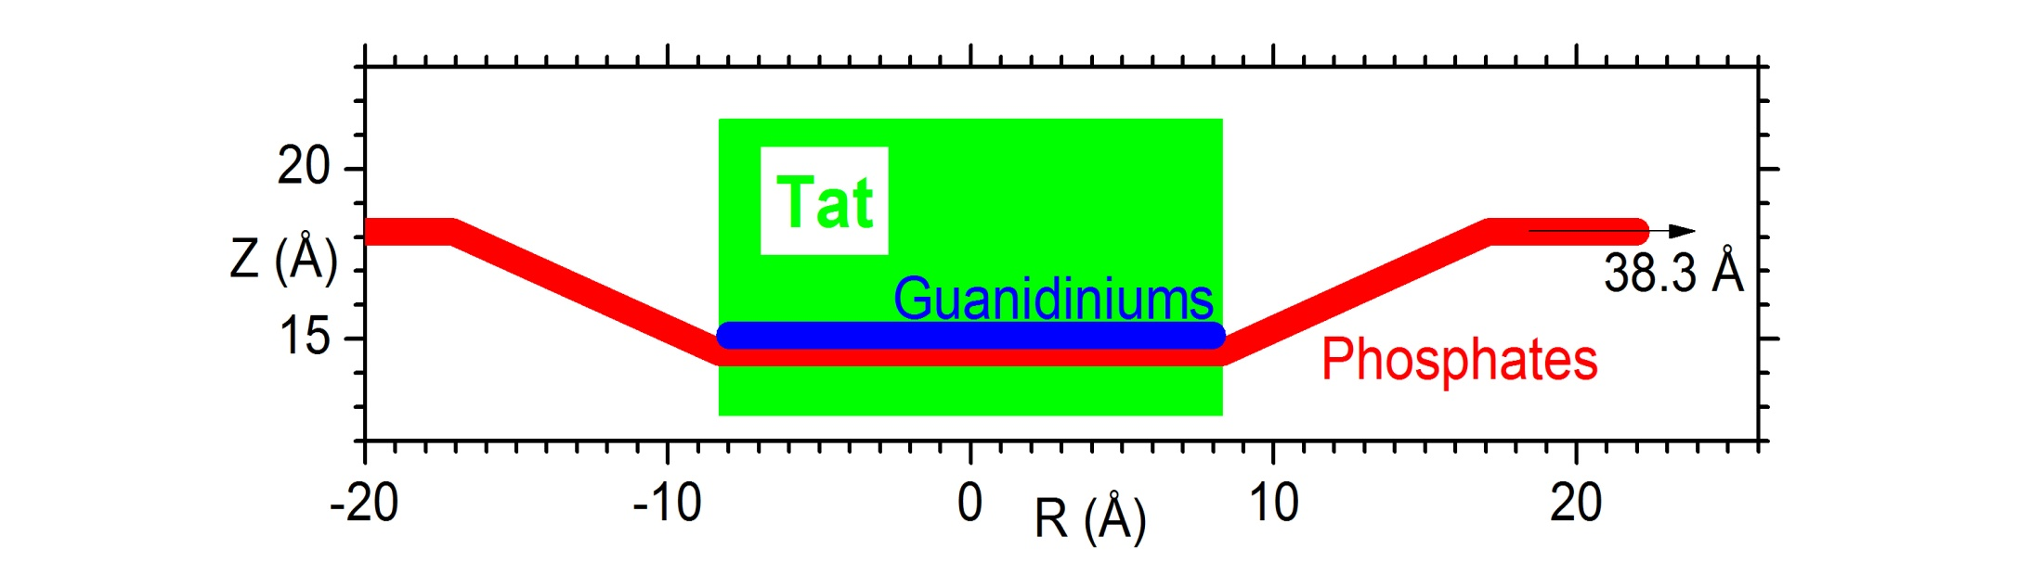
Figure 9

Slide 12
?
?
Figure 9

Slide 13
Figure 9

Slide 14
Figure 9

Slide 15
Tat
18.3 Å
14.6 Å
Bilayer center
Figure 9

Slide 16
Tat
Bilayer surface
D_{PP}(DOPC)
D_{PP}
Z_{P}
Z_{Tat}
Bilayer center
Figure 9

Slide 22
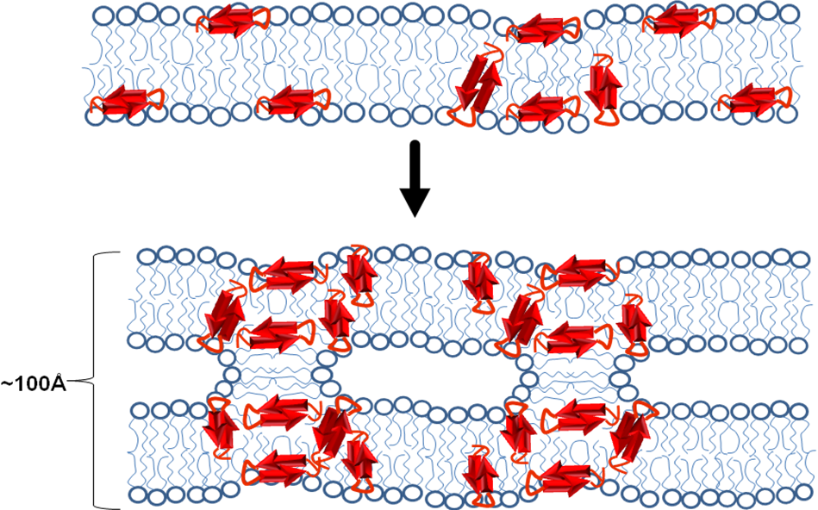
Figure 9

Slide 23
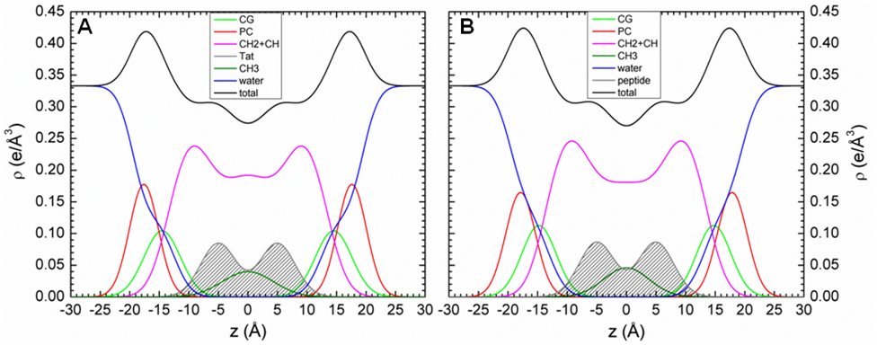
Figure 5

Slide 24
Figure 9

Slide 25
Figure 9

Slide 26
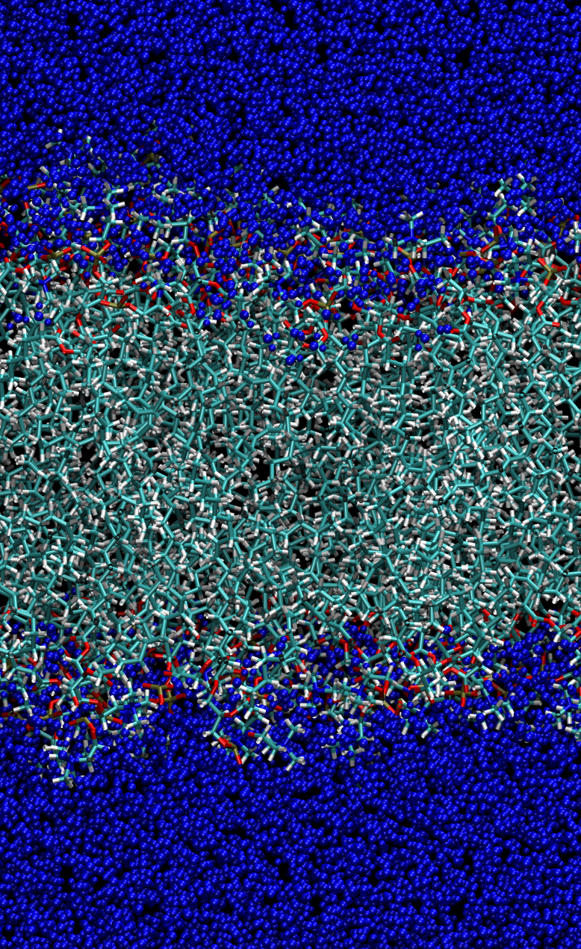
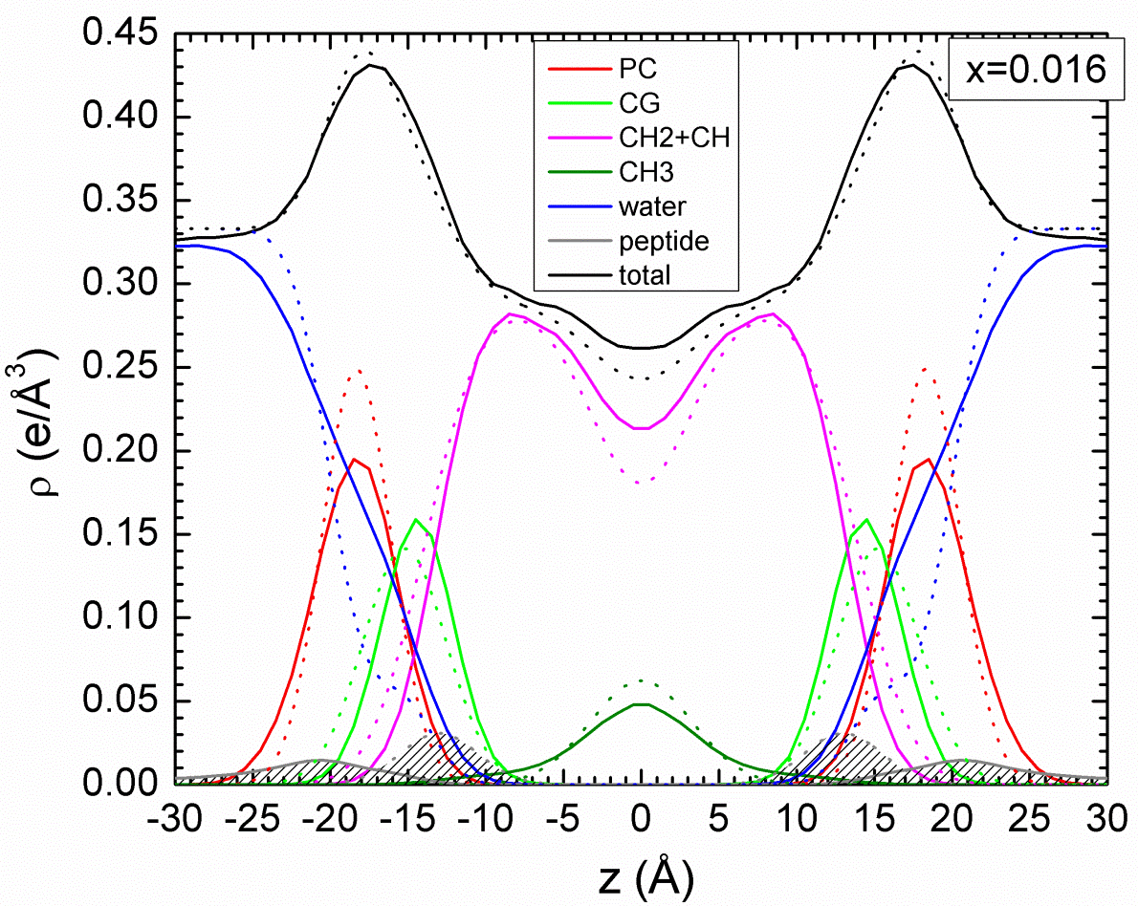
A B
Figure 9

Slide 27
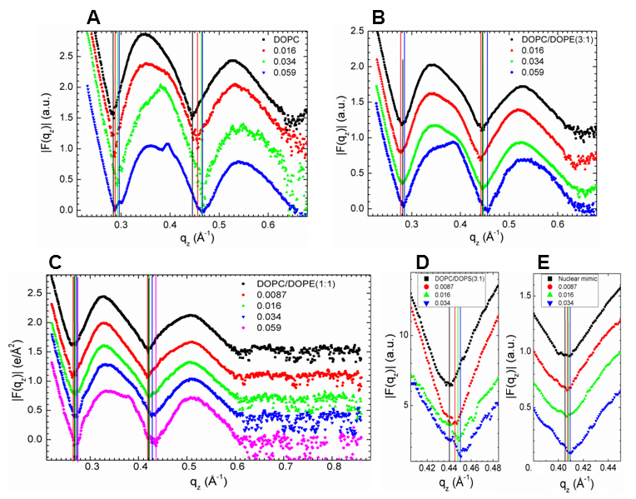
Figure 2

Slide 28
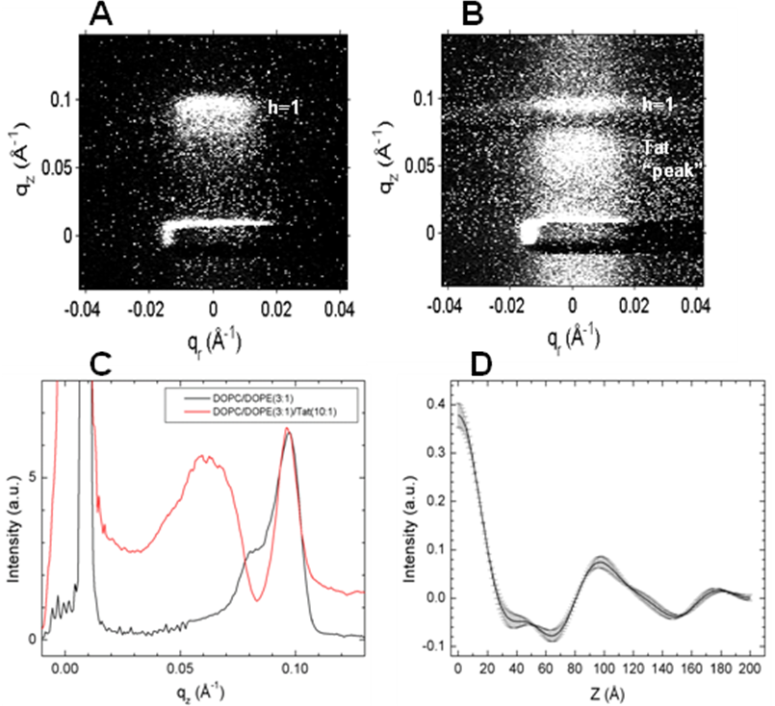
Figure 8

Slide 29
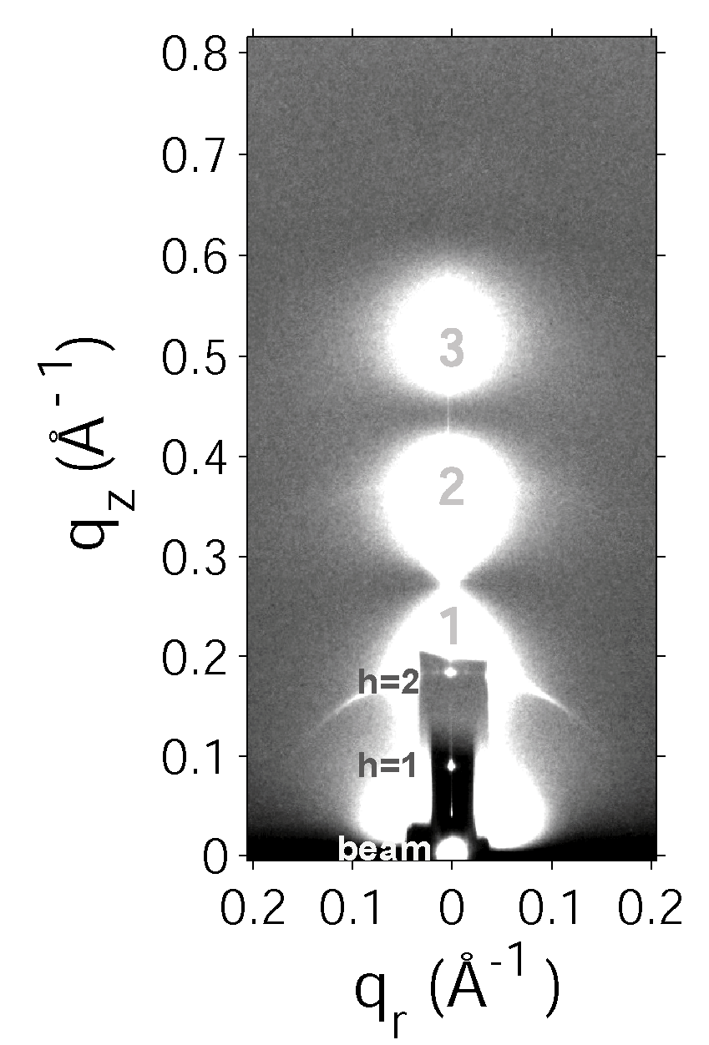

Slide 31
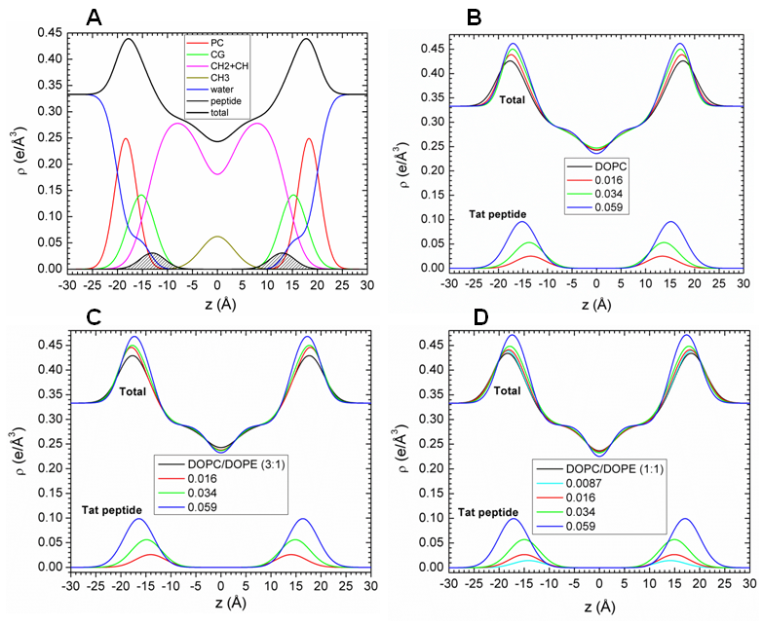
Figure 3

Slide 32


B
D
Figure 7

Slide 33
A B C

Slide 34
Figure 8

Slide 35
A B
D
Figure 7

Slide 36
Figure 2

Slide 37
Figure 3

Slide 38
A B
C D

